Slide 1
Time Series Analysis and Modelling on Hourly Usage of Electricity.
Final Term Project
Dr. Reza Jafari
Atharva Haldankar

Slide 2
Describing the data.
The original data set consist records the electricity usage for every 15 minutes.
Since 15 minutes is a very small time span, the data was converted to hourly usage.
Two more predictors were added i.e., Season and Holiday.
Season consists numbers from 1-4 & holiday consists of 0-1.
The final data consists of 17592 observations and 5 columns.

Slide 3
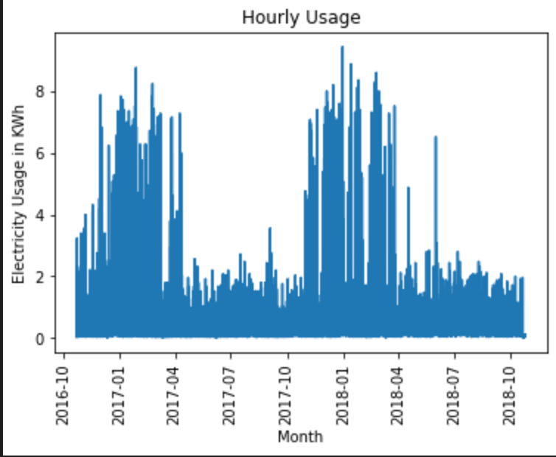
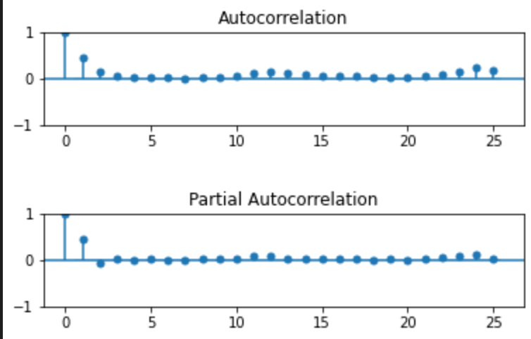
Dependent variable VS time and ACF/PACF.

Slide 4
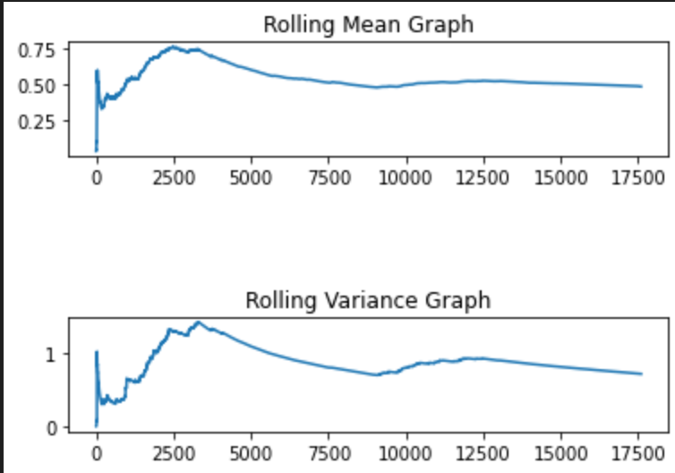
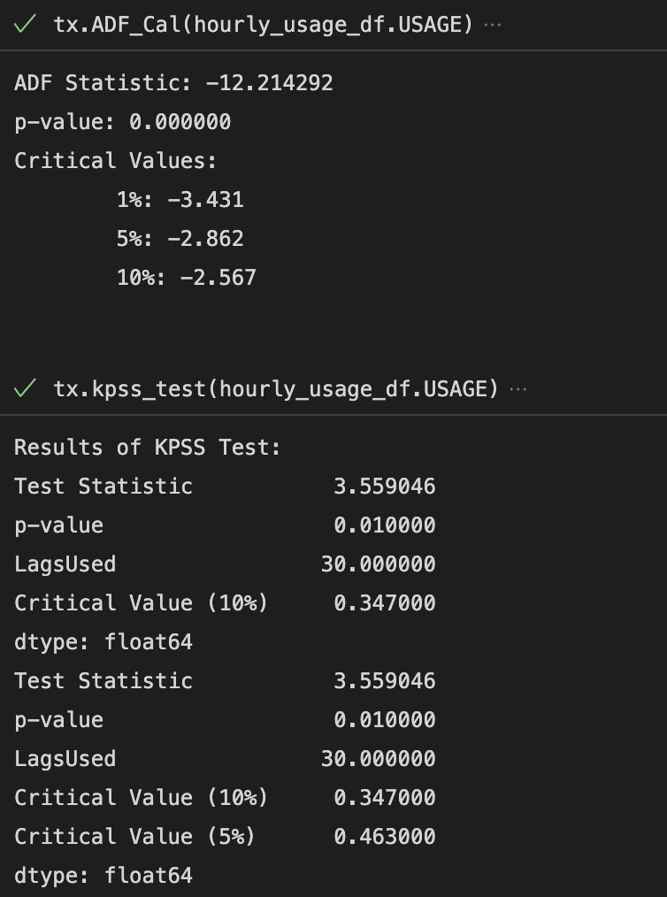
Stationarity.

Slide 5
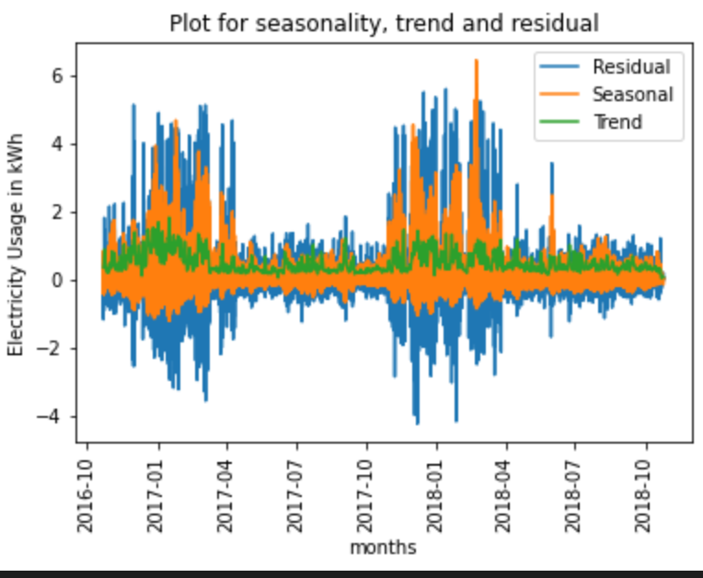
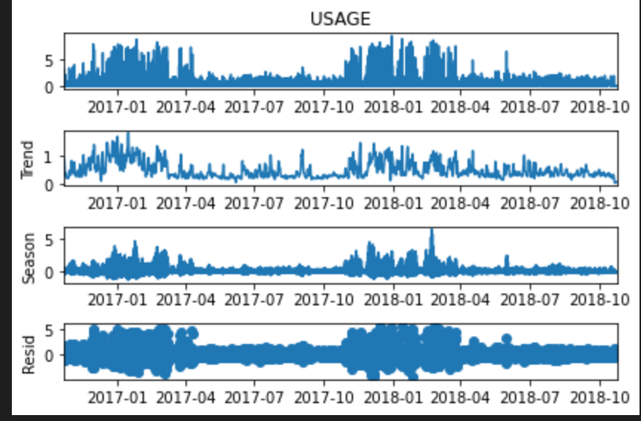
Time Series Decomposition.

Slide 6
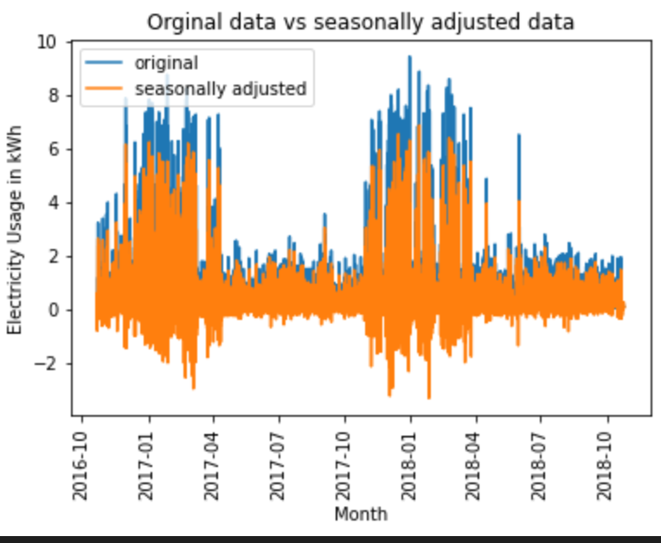
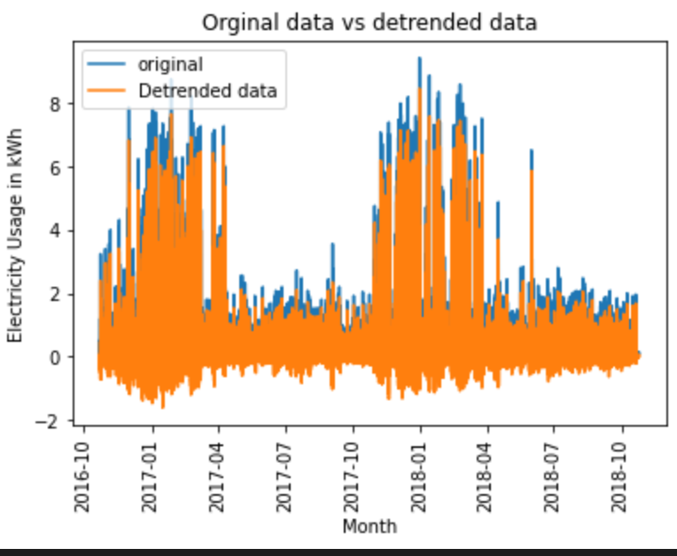
Seasonally adjusted and detrended data.

Slide 7
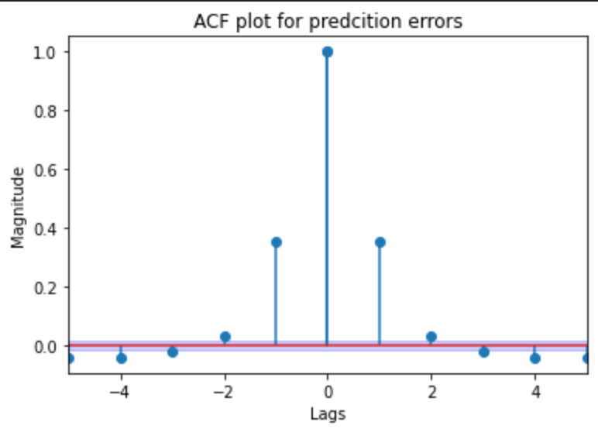
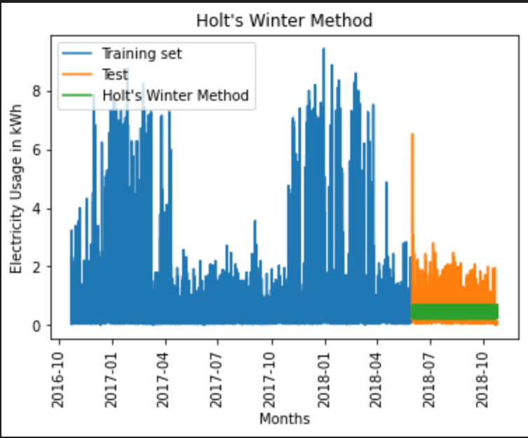
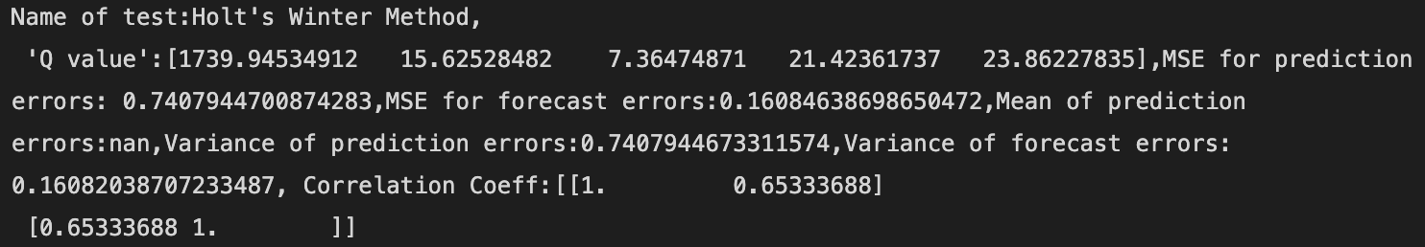
Holt Winters Method

Slide 8
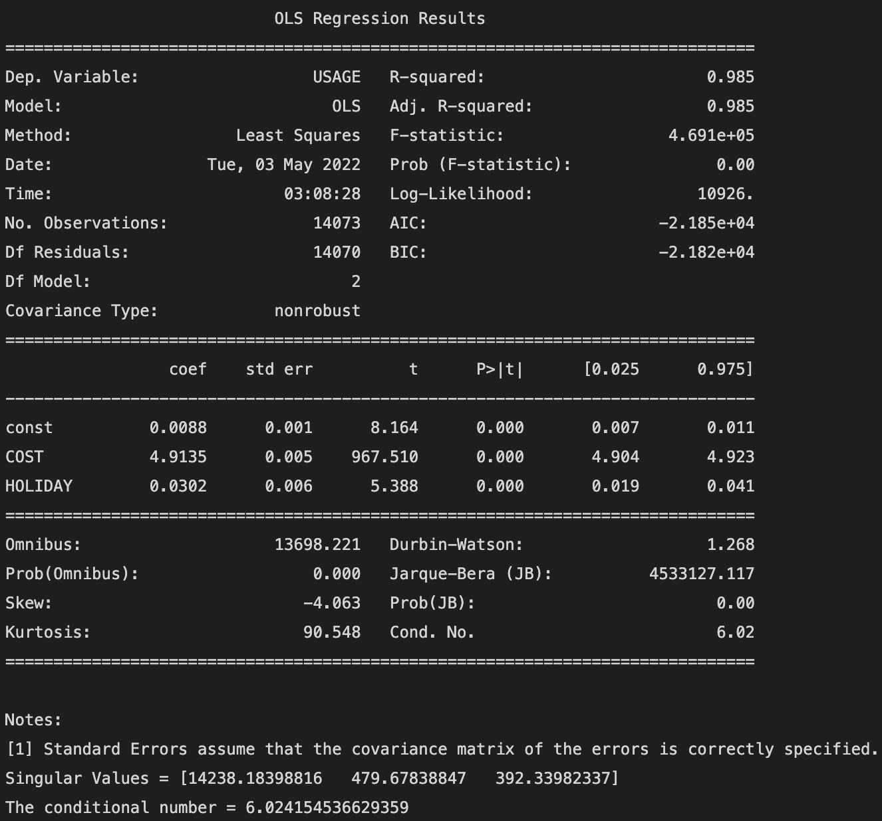
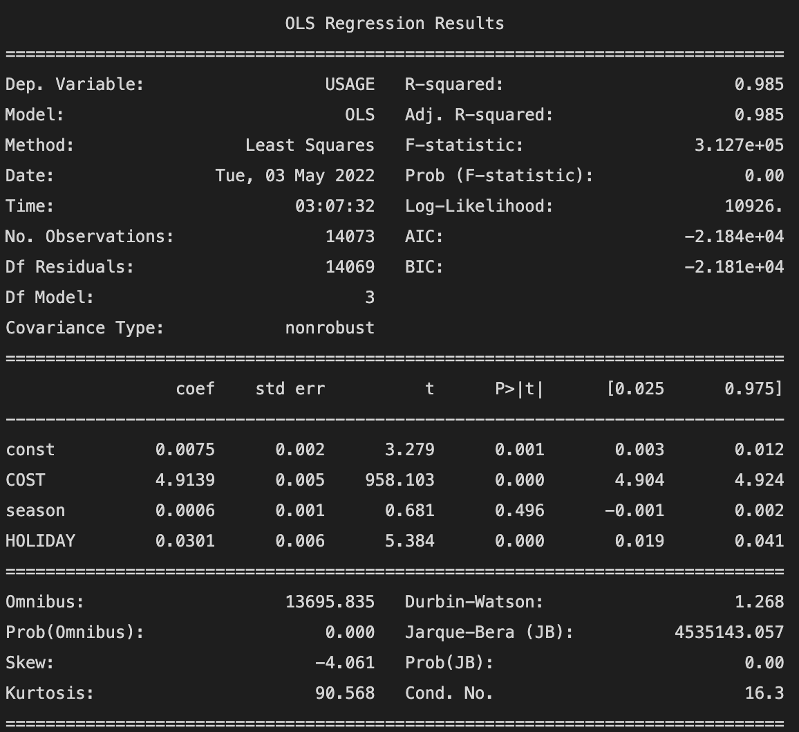
Feature Selection

Slide 9
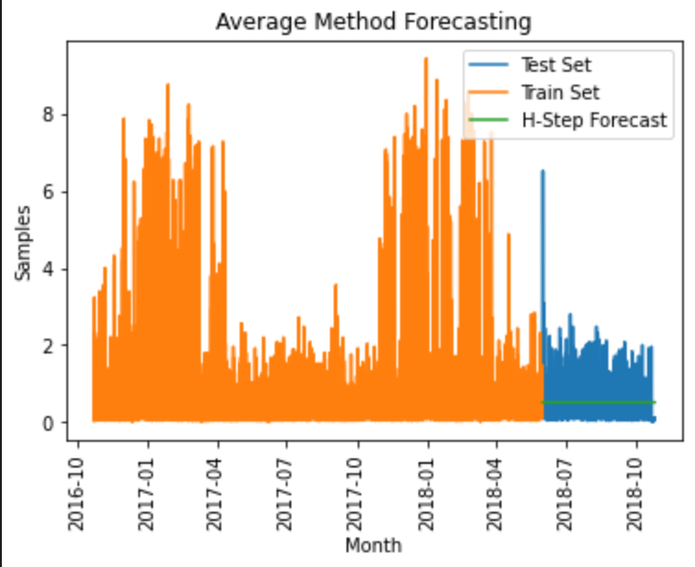
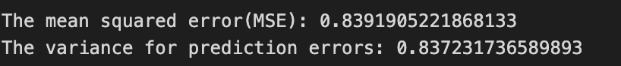
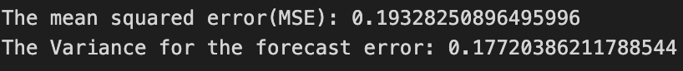
Average Method
For Prediction
For Forecast

Slide 10

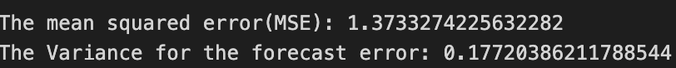
Naïve Method
For Prediction
For Forecast

Slide 11

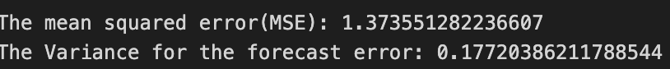
Drift Method
For Prediction
For Forecast

Slide 12
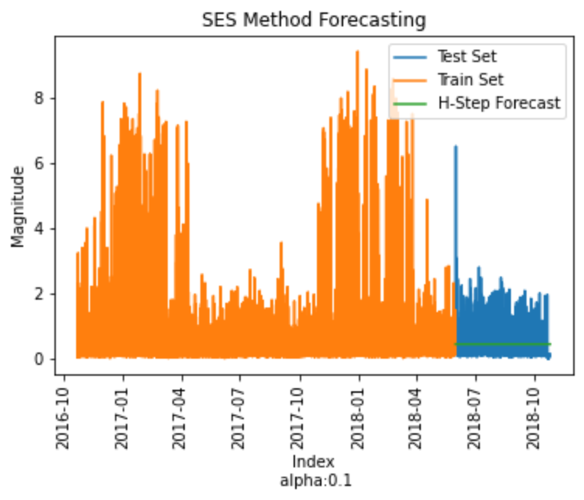
SES Method
For Prediction
For Forecast

Slide 13

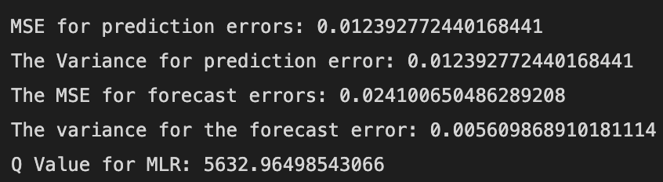
Multiple Linear Regression (MLR)

Slide 14
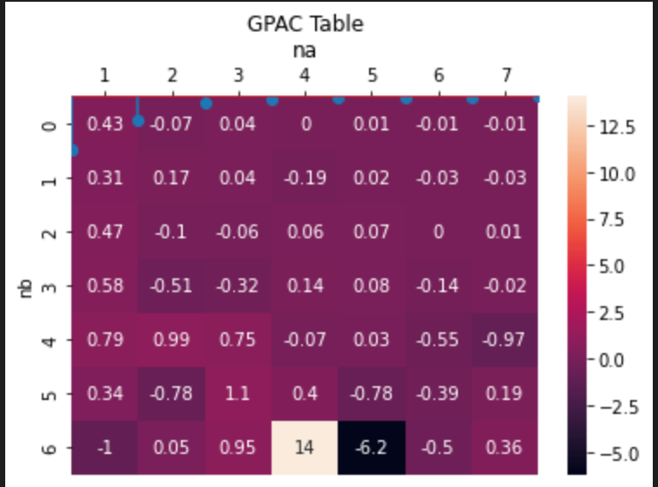
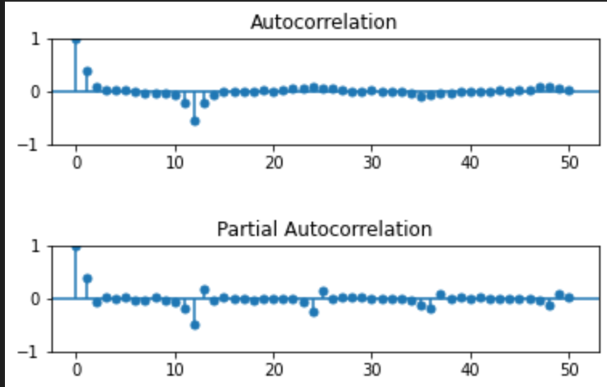
ARMA, ARIMA & SARIMA Order Determination

Slide 15
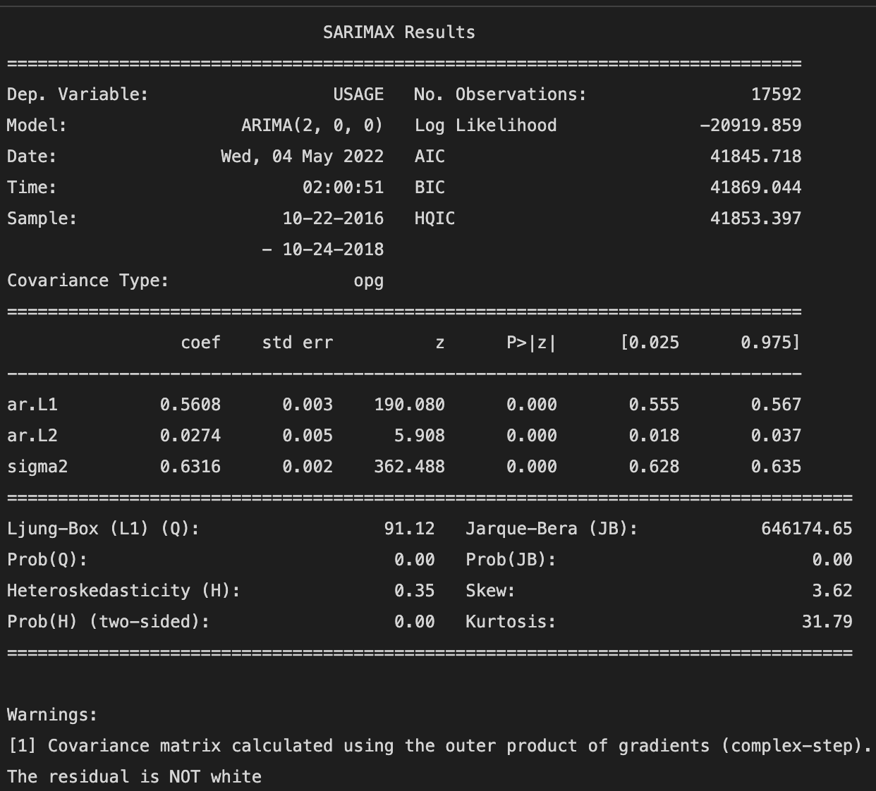
Levenberg Marquardt Algorithm

Slide 16
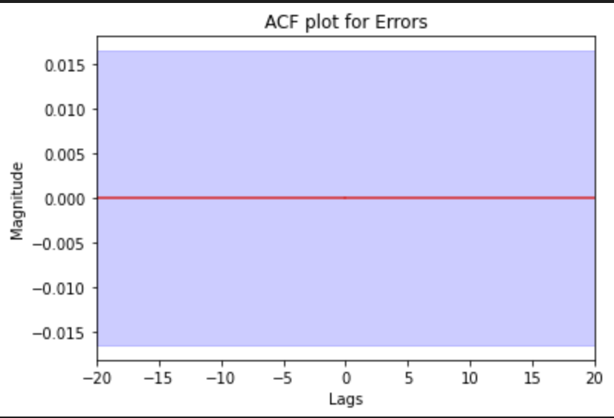
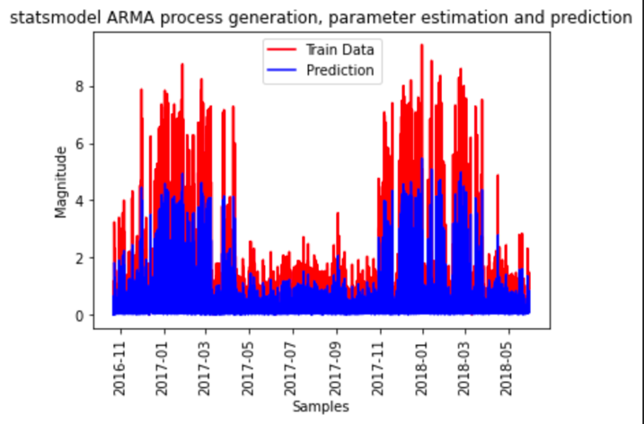
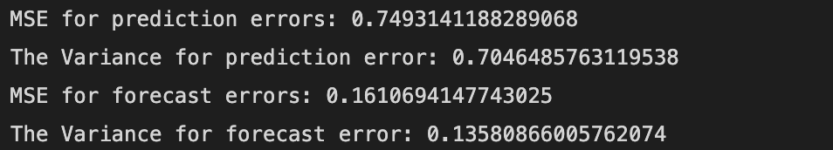
ARMA(2,0)

Slide 17
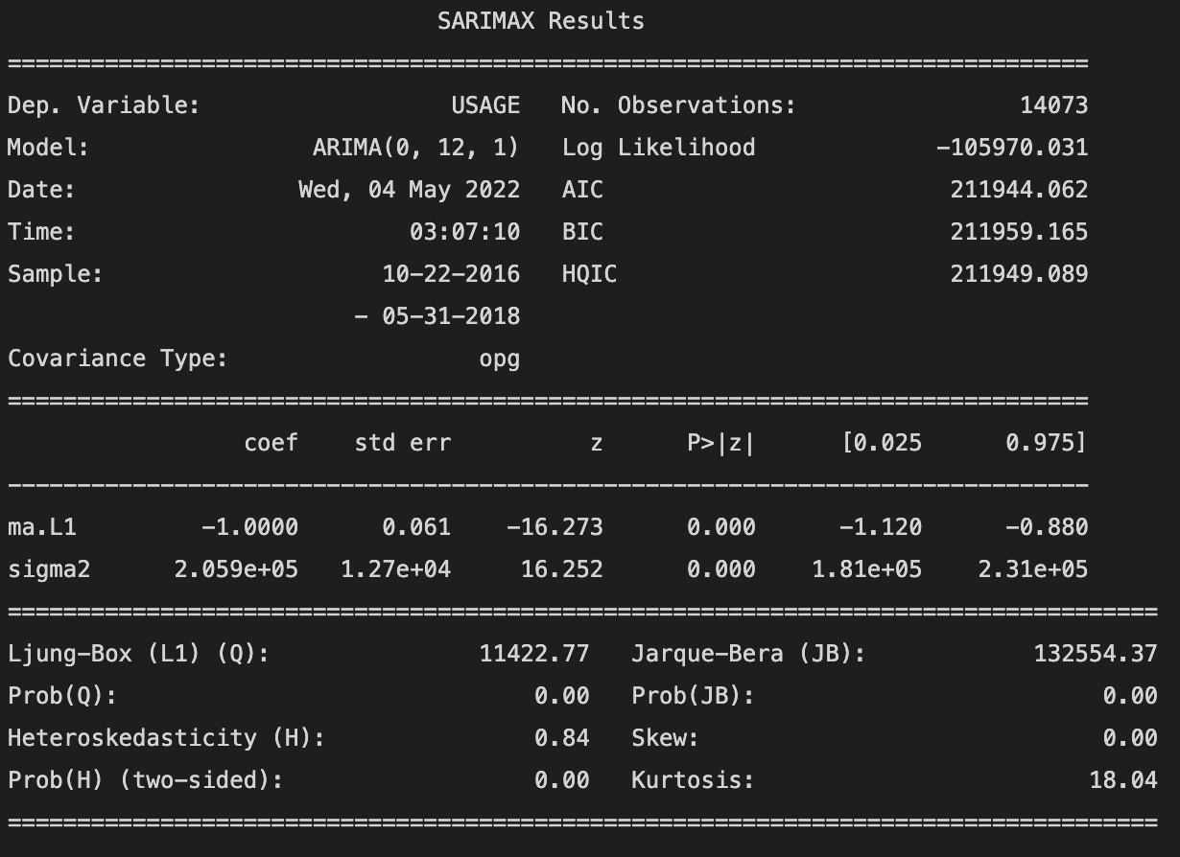

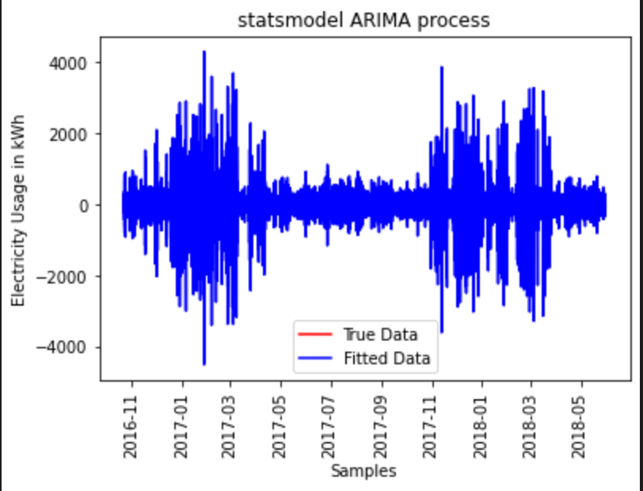
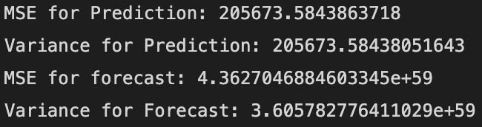
ARIMA(0,12,1)

Slide 18
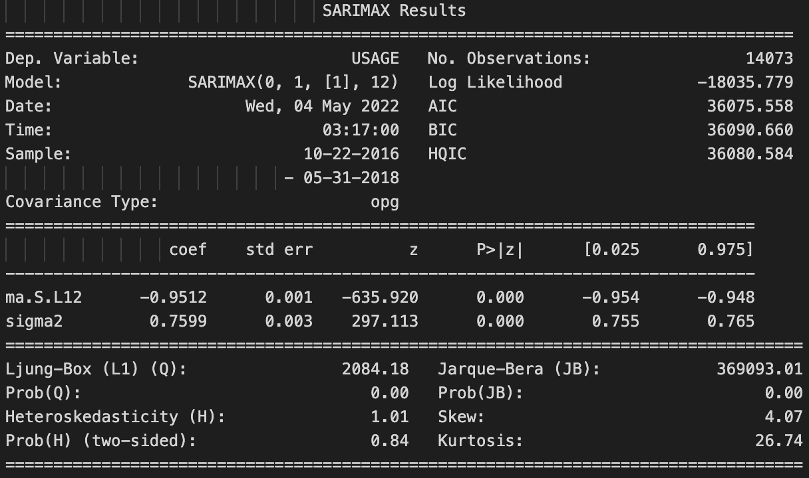
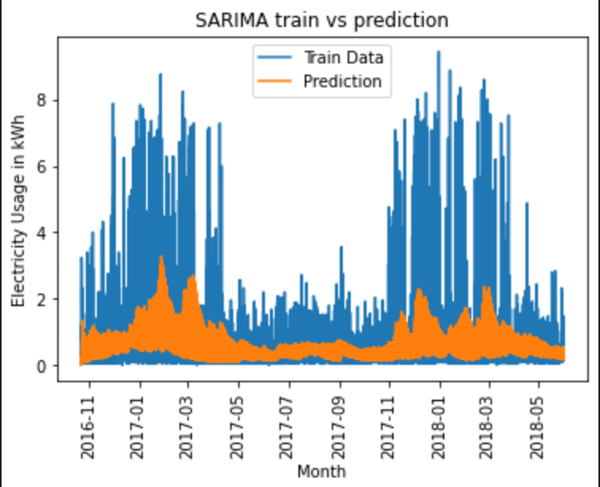
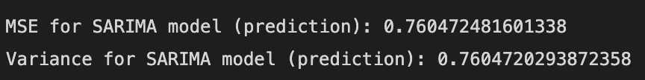
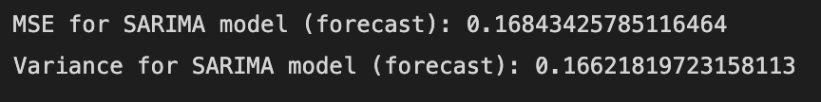
SARIMA(0,1,1)₁₂

Slide 19
Models Summary.
Model | MSE Prediction | MSE Forecast | Variance Prediction | Variance Forecast
Average | 0.8391 | 0.1932 | 0.8372 | 0.1772
Naïve | 0.9571 | 0.1373 | 0.9571 | 0.1772
Drift | 0.9575 | 1.3735 | 0.9575 | 0.1772
Holt Winters | 0.7407 | 0.1608 | 0.7407 | 0.1608
SES | 0.8007 | 0.1793 | 0.8007 | 0.1772
MLR | 0.0123 | 0.0241 | 0.0123 | 0.0056
ARMA | 0.7493 | 0.1610 | 0.7046 | 0.1358
ARIMA | 205673.58 | 4.3627 X 10⁵⁹ | 205673.58 | 3.6057
SARIMA | 0.7604 | 0.1684 | 0.7604 | 0.1662

Slide 20
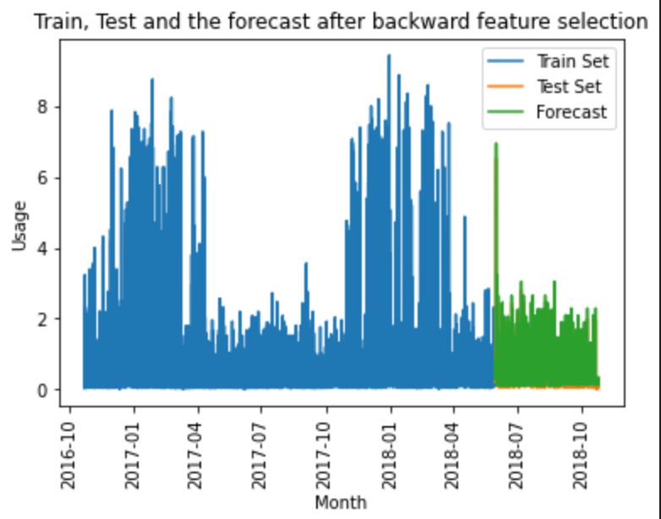
Final Model Selection & h-step Prediction.

Slide 21
Conclusion
Since the MLR had the least mean square error for the forecast and the prediction, it is the best fit for this data set.
This model has also performed very well while making the h-step predictions.
For forecasting the multiple linear regression can be used to forecast the electricity usage for the given day and time.

Slide 22
Thank You!

